Slide 1


omnisharp
@mat_mcloughlin

Slide 2
it’s a series of tools and extensions to help you work with C# outside of Visual Studio

Slide 3
first started by Jason Imison back in 2011

Slide 4
this is Jason

Slide 5
we now have extensions for some of the most popular text editors

Slide 6







Slide 7
downloads so far
Brackets: 5,474
Atom: 14,240
Sublime: around 10k
VIM & Emacs: unsure but around 400 clones a day

Slide 8
so how does it work?

Slide 9
Client
Plugin
Omnisharp Server

Slide 10
editor plugins
VIM: VimScript
Emacs: Lisp
Brackets: Javascript
Atom: Typescript
Sublime: Python

Slide 11
omnisharp server
Exposes services via http end points
v1 written using nrefactory and Nancy
v2 written using roslyn and WebApi

Slide 12
what is roslyn
a project to rewrite VB and C# compilers
exposes all stages of the compiler via and api
gives access to semantic and syntax trees for you source code
allows code fixes and refactorings to be written

Slide 13
the workspace layer
Workspace
Solution
Project
Document

Slide 14
demo time!

Slide 15
the future

Slide 16
continuing to add features to the server

Slide 17
more editor extensions?

Slide 18
better support for vnext projects

Slide 19
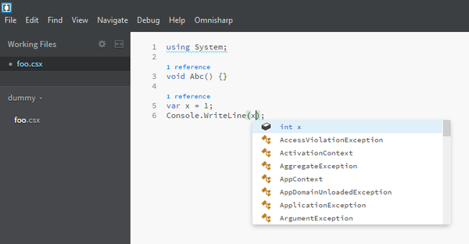
support for scriptcs

Slide 20
more code refactorings
stdin/stdout for two way communication
better test runner support
omnisharp version manager
and more…

Slide 21
debugging?

Slide 22


some of the contributors

Slide 23
getting involved
website: http://omnisharp.net
jabbr: https://jabbr.net/#/rooms/omnisharp
github repo: https://github.com/omnisharp
twitter: @omnisharp

